Slide 1

MSC AUTOMOTIVE ENGINEERING
Topic
AI ETHICS
7080MAA - CONNECTED AUTONOMOUS VEHICLE CONTEXUALISATION
Created & Presented By:
SHIBAM GHOSAL
SID - 15460424

Slide 2

AI Ethics
Overview:
Reasons for the selection of this topic.
Present & Future challenges with the topic.
Importance to Connected Autonomous Vehicles.
Significance of the topic to my future work, and successful implementation in the industry.
Ethical implications to the community, environment, etc.

Slide 3


Overview:
Ethics is the ability to think critically about moral values which determine our actions when interacting with another person.
Artificial Intelligence (AI) is an intelligent machine which runs with a set of programs developed for performing certain tasks which require human Intelligence.
Ethics of AI are principle sets developed for AI to function in a society with interaction with humans ethically.
AI technology has been started to be introduced in various sectors which typically require human intelligence to do certain types of tasks.
However, even with the many benefits AI has brought it also has its many downsides. There have been many reports of the misuse of AI technology. This begs the question if who should be responsible for the mistake made by AI?

Slide 4


Current & Future challenges related to the topic:
Safety & Reliability: Exploitation of vulnerable systems, unforeseen scenarios in the real world, and lack of clear rules and regulations may hinder development and deployment.
Data Security & Privacy: Vulnerable software is open to manipulations and hacking, access to sensitive personal information.
Decision making: Rare and unexpected may confuse AI’s perception, and high-risk situations involving weapons, and medical procedures require ethical and moral decision-making.
Data Bias: AI are trained from historical data, and biased data may lead to discriminatory outcomes.
Accountability: AI’s function as “Black Boxes” which lead to difficult interpretation of its decisions. They should be implemented with clear boundaries.

Slide 5

How AI is significant to Connected Autonomous Vehicles:
Navigation: Real-time planning of path to destination with the help of data from GPS and cameras, for route planning, obstacle avoidance, etc.
Enhanced Safety & Driver Assistance: Use of various sensors including camera and radar, to formulate an algorithm to perform tasks such as – lane change, evasive maneuvers, cruise control, auto park, etc.
Maintenance: AI can analyze data collected from the vehicle system and decide whether it needs any maintenance. This prevents breakdowns.
Personalised User Experience: AI enables users to get a personalised driving experience in automobiles such as – voice control, and infotainment system.

Slide 6
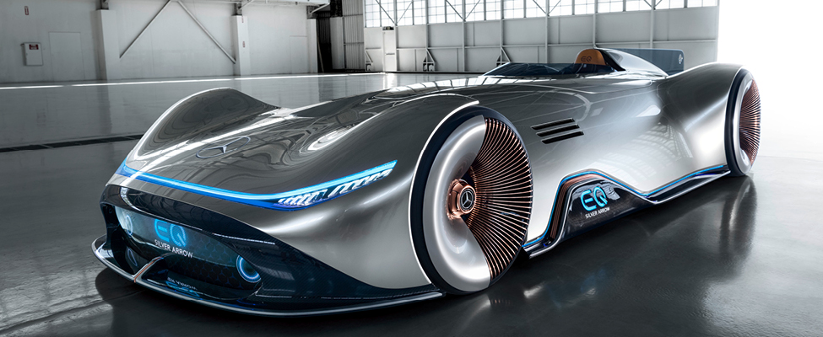
Implementation of AI Ethics in the Industry & Significance to Future Work:
Implementation -
Transparent guideline & framework: Develop new guidelines that align with ethical standards such as addressing fairness, transparency & accountability.
Developing new training methods: AI is usually trained from historical data. However, new data should be used to train AI to avoid any unexpected situation and prevent bias.
Significance –
Mitigating Discrimination – Correcting biases in AI frameworks prevents unintentional discriminatory practices.
Data Protection & Privacy – With the advancements in AI it became a threat to the privacy of personal data. Implementing privacy shields ensuring data security is a complex problem.

Slide 7
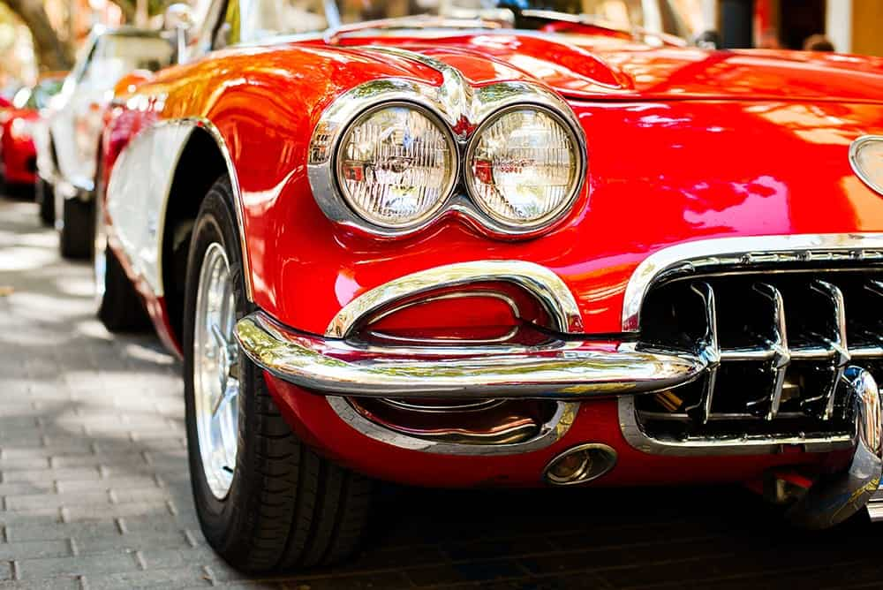
Implications of AI Ethics:
Job Replacement: debates on whether the introduction of AI into industry will create more jobs or eliminate some jobs are still ongoing (Siau, Xi, and Zou, 2019; Wang and Siau, 2019b). Reports of factory workers being replaced by automation systems is a major concern.
Accessibility: This refers to the availability of products and services for everyone, regardless of status, gender, disabilities, or age. The benefits of advanced technology should be distributed fairly.
Environmental Impact: AI-driven tools can revolutionize environmental monitoring, including deforestation, forest fires, and carbon emissions, while optimizing energy resources.
Civil & Human rights: Use of AI unethically may lead to loss of trust from the society. Software programmers should be trained with human laws before writing codes, to avoid violating any key human rights while being uninformed.

Slide 8
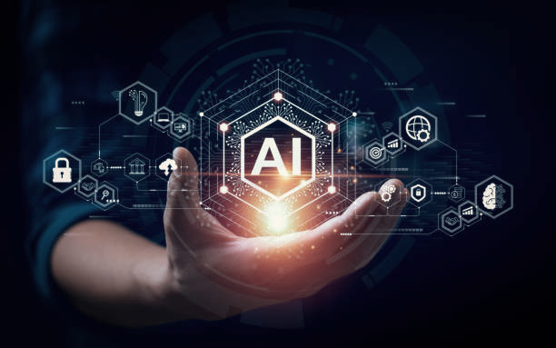
REFERENCES
Images for the making of slides:
https://www.moneybeach.co.uk/the-boardwalk/the-best-places-to-see-classic-cars-in-the-uk/
https://www.carwow.co.uk/best/best-supercars#gref
https://www.istockphoto.com/photos/ai
https://ats.net/en/focus-ai-artificial-intelligence-and-the-new-doomsday-machine/
https://www.ukposters.co.uk/fast-red-car-v127588
https://www.youtube.com/watch?app=desktop&v=_adJBzQgfsg
Research Materials:
Siau, Keng Wang, Weiyu.2020. Artificial Intelligence (AI) Ethics: Ethics of AI and Ethical AI https://locate.coventry.ac.uk/permalink/f/acu2op/TN_cdi_gale_infotracmisc_A759221189
Power, David. 2024. Ethical considerations in the era of AI, automation, and surgical robots: there are plenty of lessons from the past. https://locate.coventry.ac.uk/permalink/f/acu2op/TN_cdi_doaj_primary_oai_doaj_org_article_f68cd67957584411adae2a782bce7ca8
AI IN THE AUTOMOTIVE FIELD: THECURRENT SCENARIO. https://www.rematec.com/news/process-and-technology/ai-in-the-automotive-field
Dr Huma Shah. 2024. AI Ethics

